Slide 1
AR – VR PaaS
Team - LOCALHOST

Slide 2
Team Members: Aditya Kumar -> Project Owner Anuj Verma -> Scrum Master Dhananjai Kalra -> Development Team Mayank Joshi -> Development Team

Slide 3
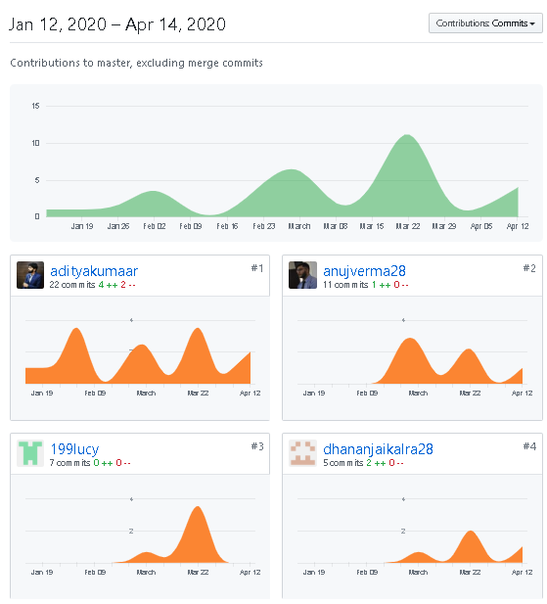
Our GitHub Activity https://github.com/adityakumaar/Agile-AR-VR-PaaS

Slide 4
Abstract: AR and VR technologies use high-end graphics and processing in order to work, which ultimately require high performance machines that are quite expensive. So if a person wants to utilize this technology, they will have to shell out a significant amount of money just on the machine itself which is not very cost effective. As rapid technological changes have become a general scenario today, purchasing such machines which support AR-VR can be categorized into an inefficient investment.

Slide 5
INTRODUCTION: This project is based on latest and emerging technologies of Augmented Reality and Virtual Reality. The main purpose of AR-VR is to provide consumers with a sense of living a limitless virtual life, which is free of any obligations. Following this idea, and the principles and values of agile manifestos, we are developing a Platform as a Service for the users who want to create their own Augmented Reality and Virtual Reality content. The services provided in this platform will target every user on any device, unbiased towards the hardware requirement. The main idea is to generalize AR-VR creation to all the users that need it, without constructing any hardware limitations.

Slide 6
Augmented Reality:
For AR content the process will be more like video conferencing, the user will point the camera in the direction he/she needs the AR content. The video will be sent to servers, users will customise the content on platform with live video in real time with all the rendering being done on the servers and the output video will be sent to the user device. This whole process will work in real time with least lag possible. The only requirement from the customer side to achieve the best possible result with least lag will be of high-speed internet connectivity with very low latency.

Slide 7
Virtual Reality
For VR content the user will need to provide the details of the environment such as dimensions, colour, objects in the scene, their placement etc., the object and environment can also be provided using suitable pictures clicked through various angles required which all will be processed, rendered and put together on the cloud and user will receive the final outcome as an interactive video on their device which will react on the basis of input provided by the user manually or through the input received by the sensors in user device.

Slide 8
Mixed Reality
For MR content somewhat a mixture of both the above processes will be used that will depend on the requirements of the user and the content will be produced accordingly.
Currently various institutions don’t use AR/VR/MR technologies due to high costs involved and also due to constant changes technology every day. As a solution to this problem, we have decided that access to our platform will be granted on a subscription basis with multiple users. A leased line to our servers will be used for highest performance possible and to be able to handle large loads as a lot of simultaneous users will use the service.

Slide 9
Service/Platform we are using.
Cloud service.
Platform as a Service (PaaS)
Why cloud ?
No need for onsite hardware or great capital expenses. Using a cloud server is well suited to small companies and individual users/creators because they may soon outgrow their storage needs and expanding storage on cloud is easy.
The cloud solutions are generally on demand so the users only have to pay for what they need.
Easy backup and restore facilities and access on multiple devices. Cloud services support automatic backup which can minimize data loss.
Automatic software and applications updates/upgrades.
Enhanced collaborations, cloud services can be accessed on multiple devices therefore, increasing the development collaborations

Slide 10
What is our platform ?
Currently, the conventional way to create AR/VR/MR content is to purchase or rent a very high-performance machine that has high graphical and processing capabilities. This leads to problems of maintenance, scalability and upgradation. Carrying out any of these processes is time consuming, as well as expensive. So as to deal with this problem, our team is creating an online platform which will allow users to create their own AR-VR content
Details are mentioned below-:
1. We plan to provide users with a platform that can be accessed using a customised app or directly through browser.
2. On login, this platform will allow them to create their respective content all on cloud. All the graphical processing will occur on our high-performance machines/servers.
3. The user will use the default/predefined packages by simply dragging and dropping it onto the canvas/interface (it will be fully customisable according to user needs) or by creating their own modules. 4. The user modules can be created by them by providing all the necessary information such as dimension, colour, etc. along with photographs or vector diagrams, which on successful creation can be used to create their content.
5. The user only needs to sign up to our service in order to access it.
6. The platform will also feature a marketplace that will be used to share, sell, buy various modules and content created by different users of the platform allowing them to explore and share their ideas with the world. This will also open a lot of opportunities for people in content creation profession.

Slide 11
Our main services
Creation: Users will be provided with different modules which they can easily drag and drop on their screen to use. The modules will be pre-defined and access to these modules will be determined by the subscription plan the user has opted.
Modification: Simply, it facilitates all the editing or modification one might want to perform later. The projects encountered under this service shall be originated/designed from the same platform.

Slide 12
Methodology used: Feature Driven Development(FDD)
Why FDD ?
We are using FDD (Feature Driven Development) methodology to develop our project as it is the best fit to develop project with multiple features. Following this methodology will allow us to add new features at every phase of development thus making it more feature rich and increasing its functionalities over time. FDD is a combination of iterative and incremental software development process. The development under FDD is carried out on client valued functionality and client’s perspective.
Development under FDD initiates with a deep understanding of the scope and context of the system and detailed models are created at each level for peer review and all the models are progressively merged into an overall wholesome model.

Slide 13
Requirements:
At SERVER SIDE: Cloud Infrastructure (High performance) -> Cloud infrastructure is made up of several components, each integrated with one another into a single architecture supporting business operations. Internet connectivity (Low latency, high speed fiber optic/5G) -> it includes dial-up telephone lines, always-on broadband connections, and wireless devices. Among these, wireless access to the Internet is the newest. For working online on cloud servers, good internet connection becomes a necessity. At USER END: Computer with basic GPU-: Any PC with a basic GPU can be used to access our platform and reap its benefits. The strain on user hardware is kept to a minimum with the use of cloud computing. Internet connectivity (high speed fiber optic/5G with low latency)-: The internet connectivity on both sides, user and us, shall be of low latency. This will engage in a smooth flow of work and will ensure the best experience on the user side. And external devices like AR, VR, MR devices on which user can run and use his creation.

Slide 14
Network Requirement
As our service is totally based on server side, to do work in real time and at good quality, we as well as the user needs a good network connection with low latency.
Network bandwidth and latency: User should have good network setup, with least latency, to work in real time environment. This is required to tackle the delay from server to user while the user is testing the software on site. Currently, 4K panoramic video only requires 20 to 40 Mbps data rate and 50 MS latency. As 5G networks contributes to considerable improvement in data rate (more than 100 Mbps) and latency (less than 10 MS), users will enjoy more comfortable viewing experiences.
Solution to network problem: If the network fluctuates frequently, then the video quality in testing process can be compromised. While at the time of downloading of the final project, the quality will be of the highest standard.

Slide 15
Market Place
We are planning to provide our users with an online marketplace which can be accessed through our platform where the users can sell or buy the AR/VR/MR content. The facility of module creation and manipulation provided to the users can also be sold on the marketplace. Module creation will allow the users to extend their reach into creating new tools and processes. These modules, whilst inclusive to the platform, will be allowed smooth circulation through the marketplace in accordance with both user and company rights.
The marketplace will encourage users to show their creativity and attract more developers towards these emerging technologies and help other buyers to easily find suitable content for their next big idea. We believe that this close interaction between users, brought through exchange of commodities, will become a necessary aspect in the near future. Thus, whilst ensuring creativity, authenticity and credibility this marketplace will also be helpful in ensuring the platforms expansion into many other suitable businesses.

Slide 16
Target Audience
Institutions/Organizations
Game Developers
Engineers and Architects
Data Analytics and Visualization
Manufacturing and automotive
Movies and television
Workforce development

Slide 17
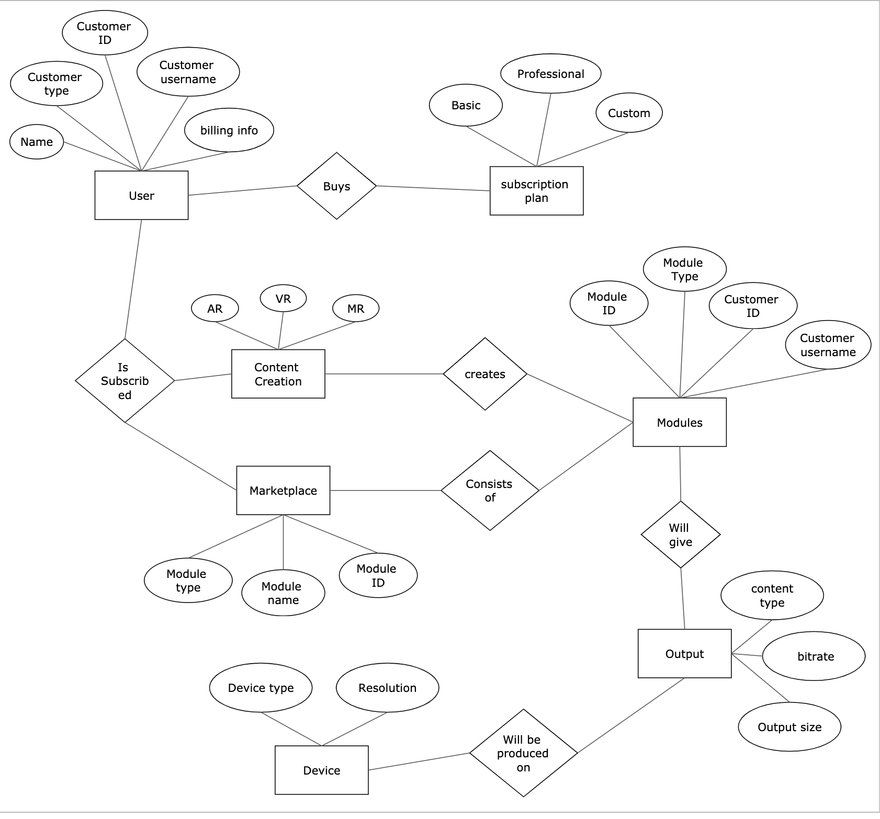
Entity Relationship (ER) Diagram

Slide 18
GO TO 255:255:255:255 BIXX

